Slide 1




Work-based learning
Click on the speaker on each slide to learn more!
Parent and Student Orientation

Slide 2
Welcome To Work-Based Learning
Parents and Students,
Welcome to Work-Based Learning!
  Congratulations on selecting a program that will help your student develop both personally and professionally. This is a wonderful opportunity for them to gain the competitive advantage for a successful future in a career field of choice. Students enrolled in WBL leave school early each day to pursue a position of interest in a local business.
  Work-Based Learning extends the traditional classroom and traditional styles of learning to the real world. It is the perfect pairing of academics and application.
  It is also an exciting opportunity to earn credit towards high school graduation while working in an exciting career field.

Slide 3

Parent/Guardian Role
  Your student’s success will depend on your support and understanding of the WBL Program. Please take time to review the documents your student will bring home from the program.
  You will be reviewing with your student the documents mentioned in this presentation. Please sign each document so your student may return promptly to their WBL Coordinator.
  Your student’s WBL Coordinator will be a local school teacher who will evaluate and support your student in this program. They will make regular contact with your student’s employer to assist both the employer and the student with the placement.

Slide 4

Parent/Guardian Role
Your student will need your support to fully enjoy the fantastic opportunities in WBL. At times they may need your advice as they work through work-related situations.
Students in this program are encouraged to find a paid or non-paid position a career related field for which they have interest.
They should also plan to stay in this position at least through the length of the WBL course. It’s important the student seek a position that matches their interest, abilities, values , and scheduling constraints to minimize conflicts related to working
When a student accepts a paid or non-paid position at a business partner’s place of business, the student is expected to follow all guidelines and protocols .
Parents, transportation to and from work is both your and the students responsibility. Please assist your student to ensure they are able to get both to and from their job.
Your student must be covered by your personal health insurance or school insurance as well as accident insurance.
Parents will need to allow the release of student records regarding academic performance, attendance, and discipline for the purpose of employment and program follow-up.
Career Related Education Manual 2012

Slide 5

Required Copies of Following:
Driver’s license (if driving to/from work)
Auto insurance
Health insurance card
Required Forms Signed by Mentors, Parents and Students
Training Agreement with all signatures
Termination Form
Confidentiality Statement

Slide 6

Required Forms Signed by Parents and Students Only
Parent/Guardian Consent Form
(MUST initial all areas)

Slide 7

Attendance Rule
Parents and Students:
It is imperative you understand the no school/no work policy.
As expected, a student’s first responsibility is to their education.
Students must go to school in order to go to work unless previously approved by the WBL Coordinator. A student may not miss school and report to work in the same day. Refer to the “Training Agreement” for details related a violation of this policy.
It is possible to fail the program and to be terminated from the program for violations related to no school/no work.
Career Related Education Manual 2012

Slide 8

Evaluation of WBL Students
Students will be evaluated by the WBL Employer and Coordinator once during each grading period. Basic employ ability will be evaluated each time.
Produces quality work
Reports to work promptly when scheduled
Uses time wisely
Demonstrates honesty and integrity
Demonstrates responsible behavior
Cooperates with others
Responds to feedback constructively
Uses/maintains materials and equipment appropriately
Follows company policies
Maintains appropriate personal appearance
Career Related Education Manual 2012

Slide 9
Evaluation of WBL Students
A training plan will be developed by the student’s coordinator and will outline skills and abilities the student should be able to perform on the job. This is also an evaluation tool used to assess whether the student is learning the skills required to perform the job successfully.
An example of a computer systems operator is below.
# 2 | Communicate project information through presentations, technical reports or white papers.
Task # 3 | Communicate with staff or clients to understand specific system requirements.
Task # 4 | Complete models and simulations, using manual or automated tools, to analyze or predict system performance under different operating conditions.
Task # 5 | Configure servers to meet functional specifications.
Task # 6 | Define and analyze objectives, scope, issues, or organizational impact of information systems.
Task # 7 | Design and conduct hardware or software tests.
Task # 8 | Develop application-specific software.
Career Related Education Manual 2012

Slide 10
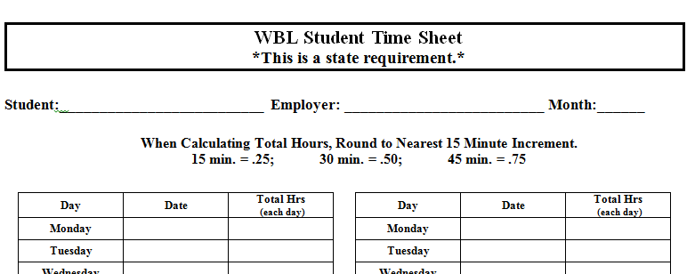
Wage/Hour Time Sheet
Every day your student should record the hours they work on the job. They will be required to have a supervisor to sign time sheet at the end of each month.
The WBL Coordinator will provide a schedule for turning in this form.
Career Related Education Manual 2012

Slide 11
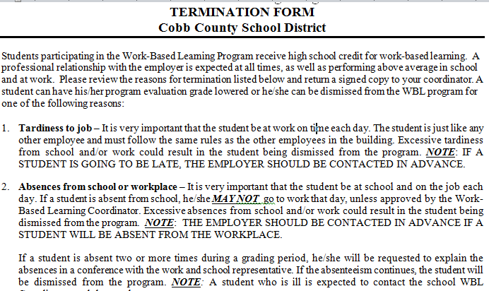
Receiving Credit For WBL
Each WBL student should take their work position seriously. Being on time to work, reporting to work when scheduled, following all legal and ethical guidelines, maintaining grades, learning required work-related skills are all important areas for success in the program. The “Termination Form” details expectations of students. It is important for students to follow these to receive a passing grade and credit for WBL.

Slide 12
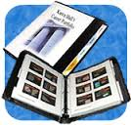
Journals and Career Portfolio
Each WBL Student will be required to complete a series of journals as well as a career portfolio that will be completed over the course of the program.
The portfolio will help students build a series of items that will be helpful as the student applies for internships, future employment, and college.
It will include items such as a resume, cover letter, letters of reference, follow up letter and more.
Students will also be required to meet with their coordinator on a regular basis during the program.
The journals, portfolio and meeting will be another assessment tool for the coordinator to evaluate the student’s progress.
Career Related Education Manual 2012

Slide 13
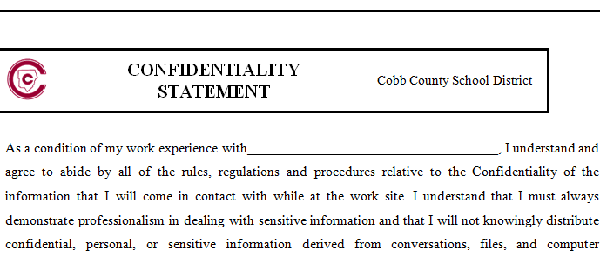

Confidentiality Statement
Students must always demonstrate professionalism in dealing with sensitive information exposed to on the job. Students should not discuss or knowingly distribute information learned while working.
Students are asked to sign a confidentially statement and should carefully review and understand the consequences related to this statement.

Slide 14

Mentor
The employer should assign a mentor for the student.
This individual should be an employee who can offer advice and devote time to assist the student and encourage the success of the student.
The mentor should be someone the student can emulate.
The mentor should have a experience at the job and ability to assist the student in training.
An employer mentor is an important part of the WBL Program.
Career Related Education Manual 2012

Slide 15

In summary, the Work-Based Learning program is an opportunity to gain the competitive advantage while working in a career field of interest.
Since students are allowed to leave school for their position and receive graduation credit for the successful completion of the program, students have a series of documents including an Application, Training Agreement, Termination Form, Confidentially Statement, and Consent Form the outlines the duties and responsibilities of the students, employers and coordinator.
Thank you for supporting the WBL Program. Success of this program for all students requires a partnership between the school, parents, student and employers.

