Slide 1
Introduction to Flowcharts
A flowchart is a diagram that represents a set of instructions. Flowcharts normally use standard symbols to represent the different types of instructions. These symbols are used to construct the flowchart and show the step-by-step solution to the problem.

Slide 2
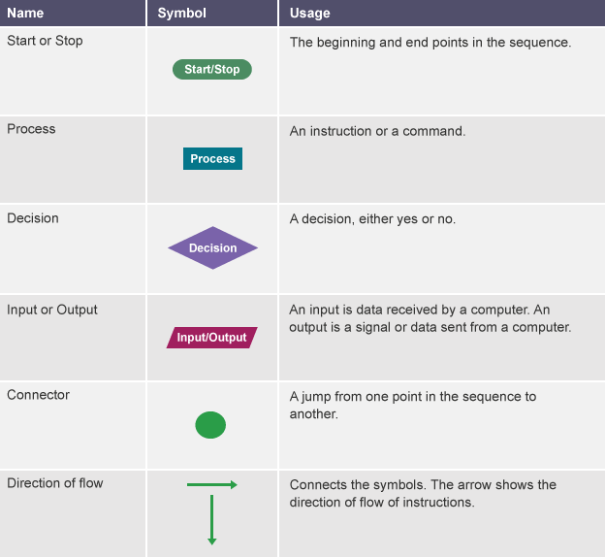
Common flowchart symbols

Slide 3
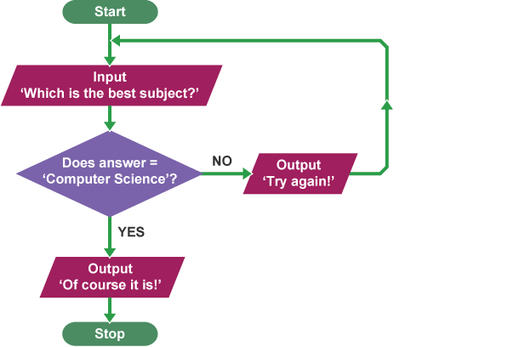
Flowcharts can be used to plan out programs. Planning a program that asks people what the best subject they take is, would look like this as a flowchart:

